Slide 1
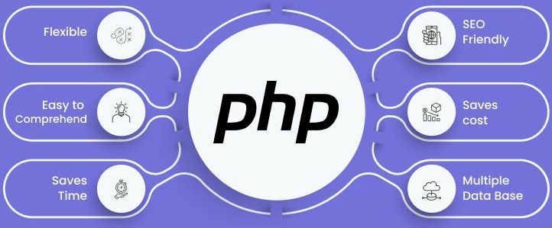

Slide 2
About today…
if statement
If-else statement
switch statement

Slide 3
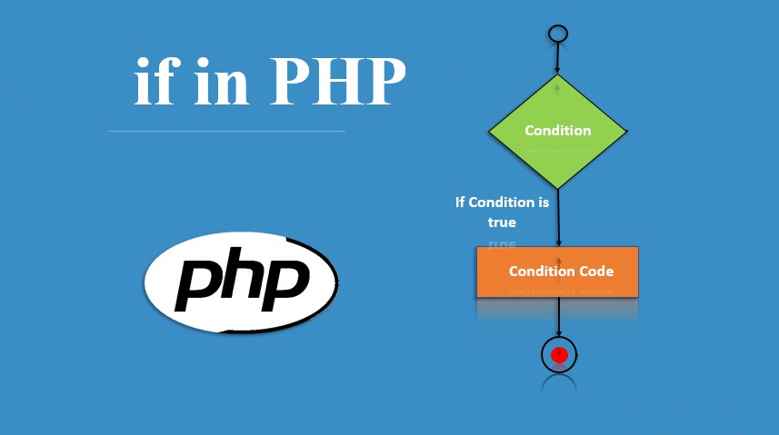

Slide 4
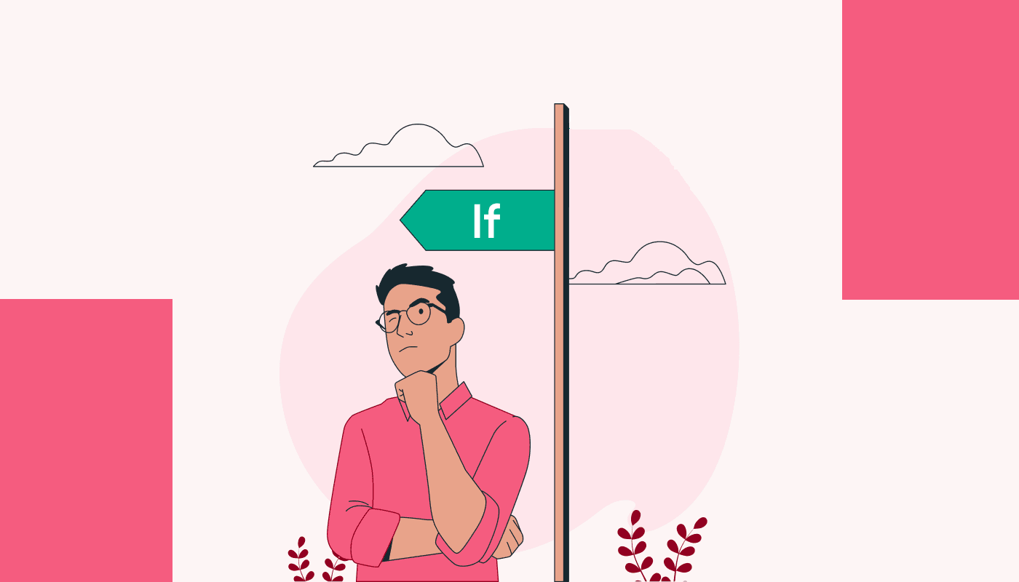
Introduction
Executes a block of code, if the given condition results true

Slide 5
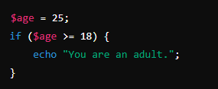
Syntax
if (condition) {
code block
}

Slide 6
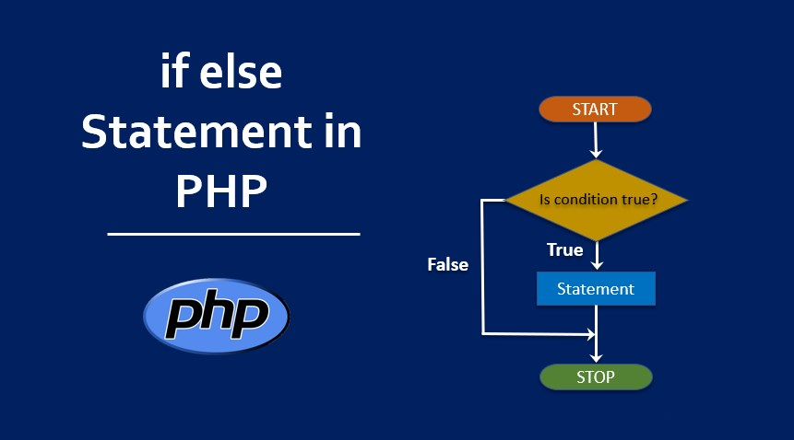

Slide 7
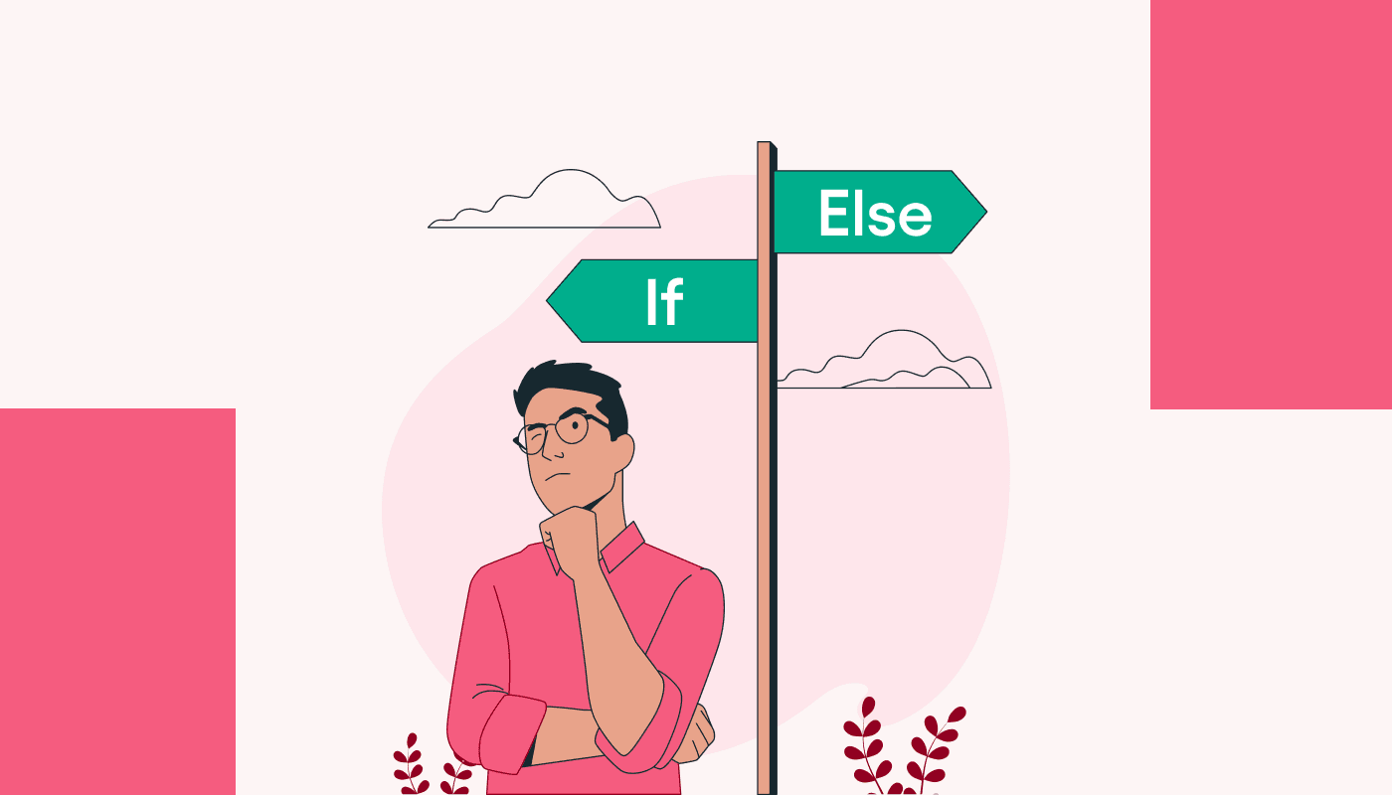
Introduction
Executes first block of code, if the given condition results true
Executes second block of code, if the given condition results false

Slide 8
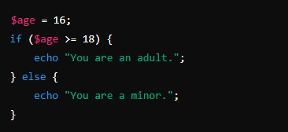
Syntax
if (condition) {
code block
}
else {
code block
}

Slide 9
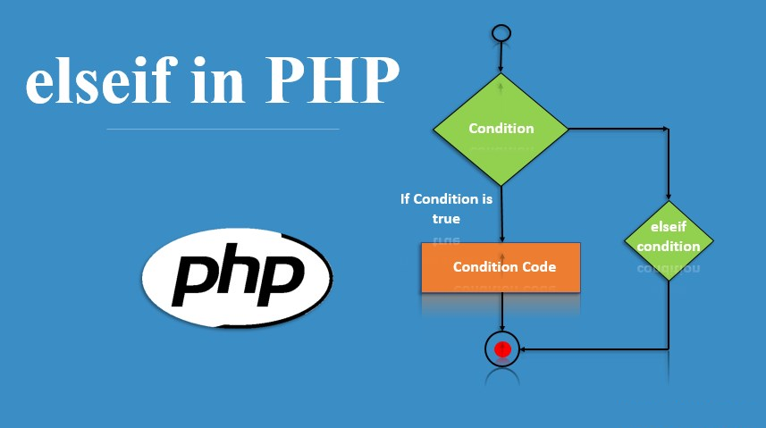

Slide 10
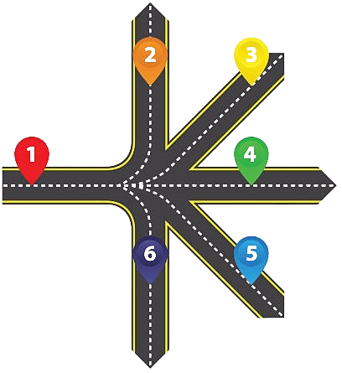
Introduction
Executes the block of code, whose given condition results true
If no condition is true,
executes the last “else” block

Slide 11
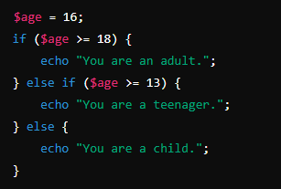
Syntax
if (condition) {
code block
}
else if (condition) {
code block
}
else {
code block
}

Slide 12
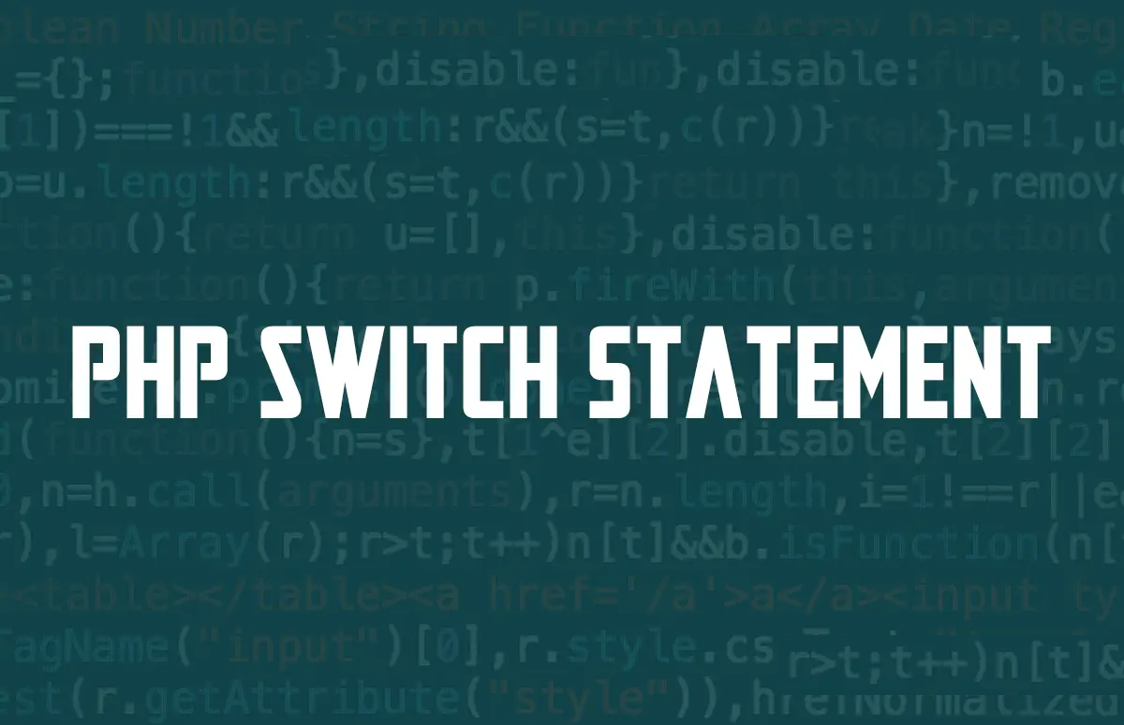

Slide 13

Introduction
Executes the case whose condition matches the given value
If no such case is present, executes last “default” case

Slide 14
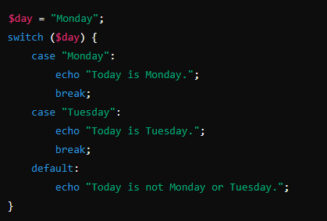
Syntax
switch (expression) {
case value1 :
code block
break;
case value2 :
code block
break;
default :
code block
break;
}

